Slide 1
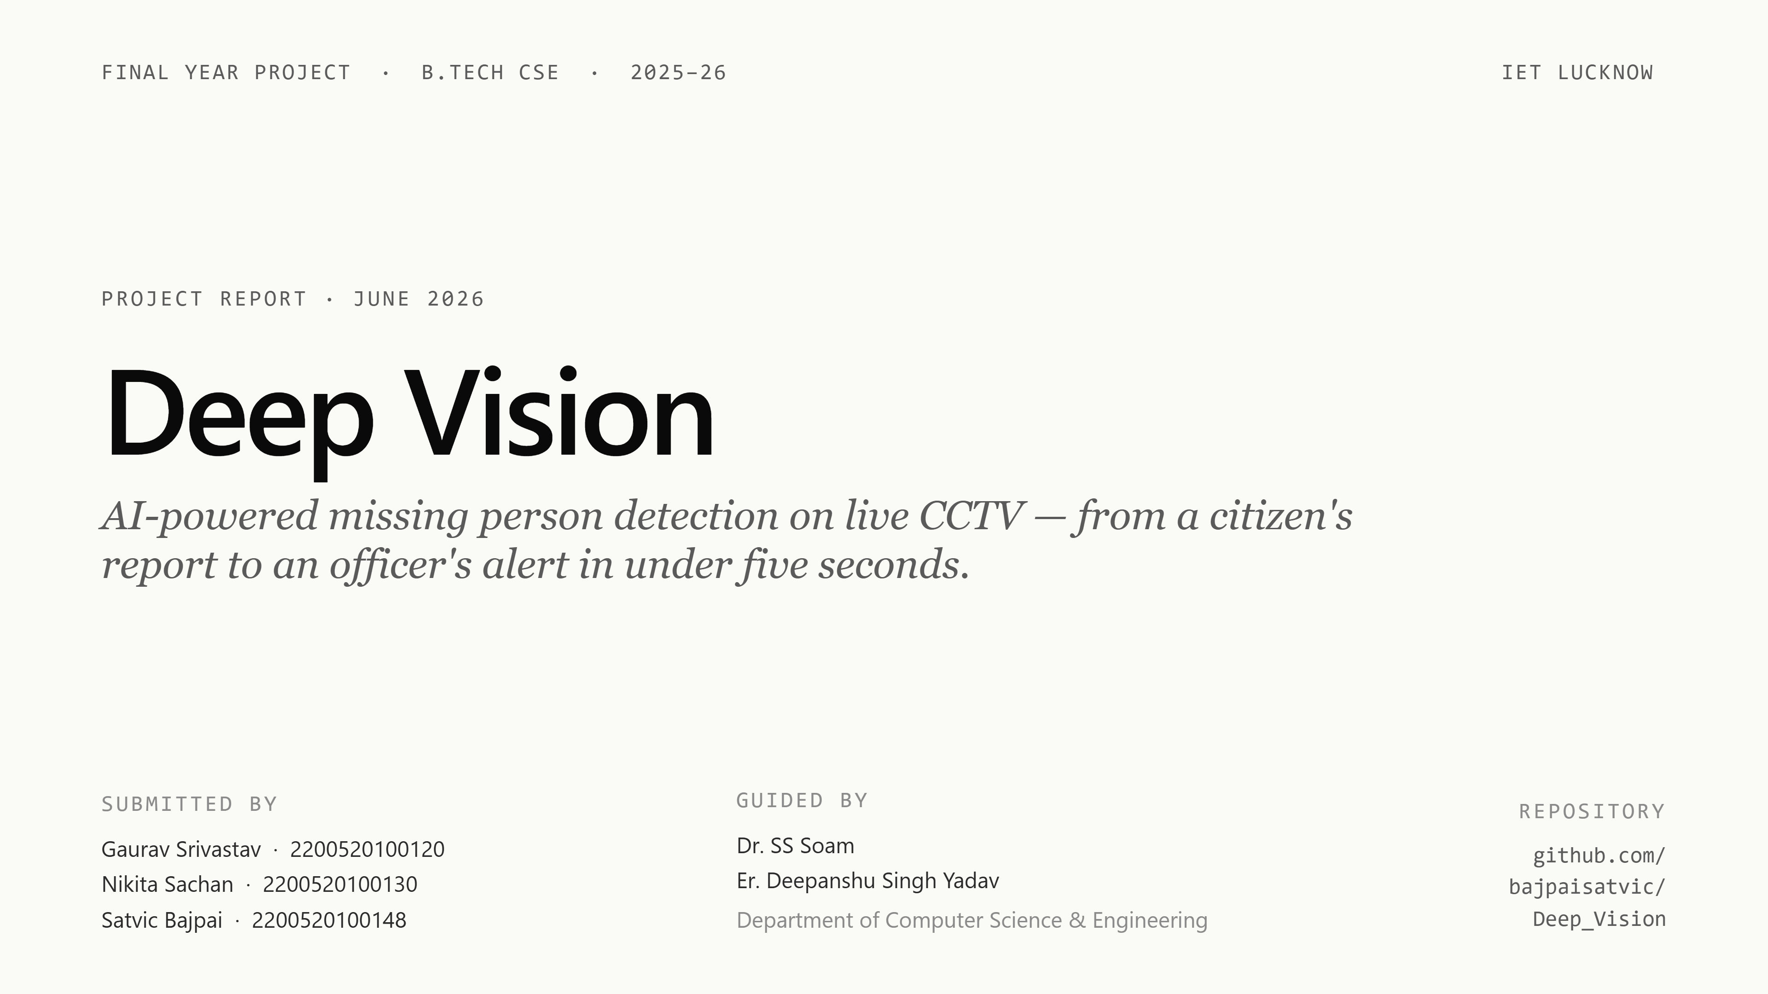
Notes:
Good morning everyone. We're presenting Deep Vision — an AI-powered platform for detecting missing persons from live CCTV feeds. I'm Satvic, and along with Gaurav and Nikita we built this under the guidance of Dr. SS Soam and Er. Deepanshu Singh Yadav. Over the next fifteen minutes I'll walk you through the problem, the architecture we designed, the AI pipeline at the core, and the results from our functional testing.

Slide 2
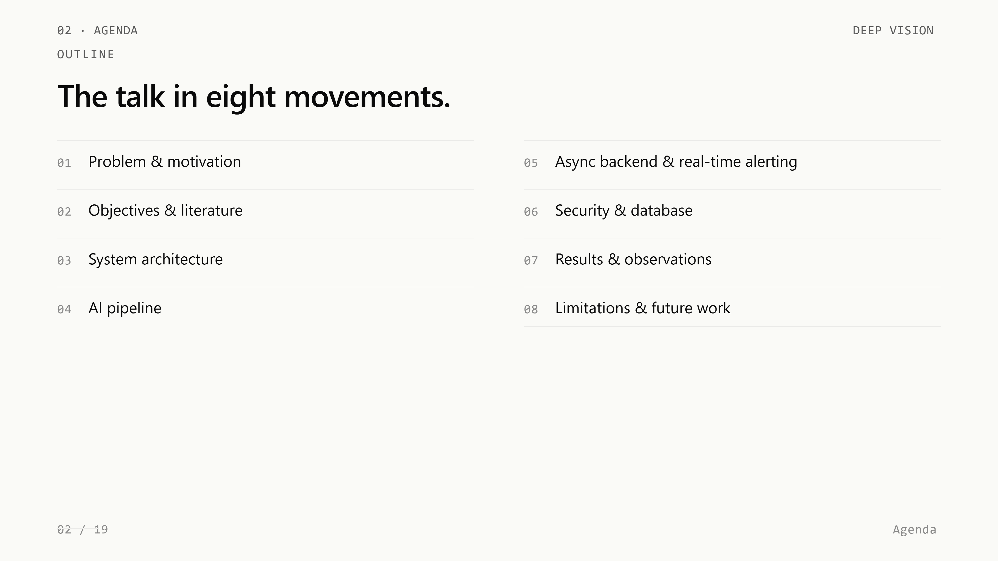
Notes:
Here's the structure of the talk. We'll start with the motivation and the gaps in current methods, then move into our system architecture and the AI pipeline. After that we'll cover the async backend, real-time alerting, security, and database. We'll close with results, limitations, and future work.

Slide 3
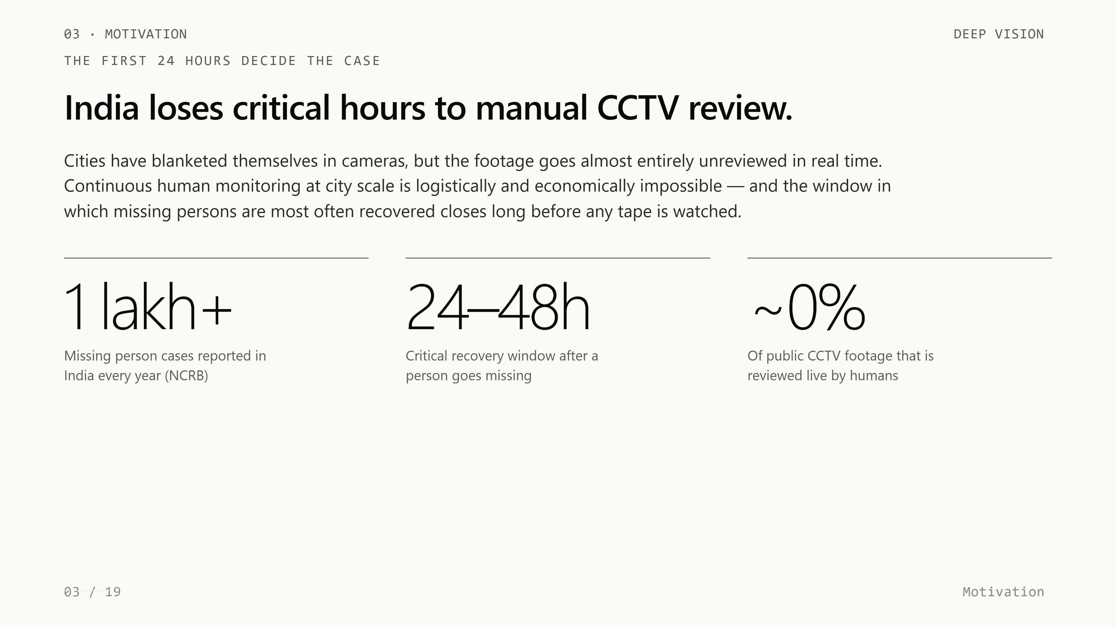
Notes:
Let me start with the problem. The NCRB reports more than one lakh missing person cases every year in India. Cities have thousands of CCTV cameras, but their footage is almost never reviewed in real time — it's reviewed only after the fact, manually. Continuous human monitoring at city scale is simply infeasible. The first twenty-four to forty-eight hours of an investigation are the most critical, and they're exactly the hours we're losing today.

Slide 4
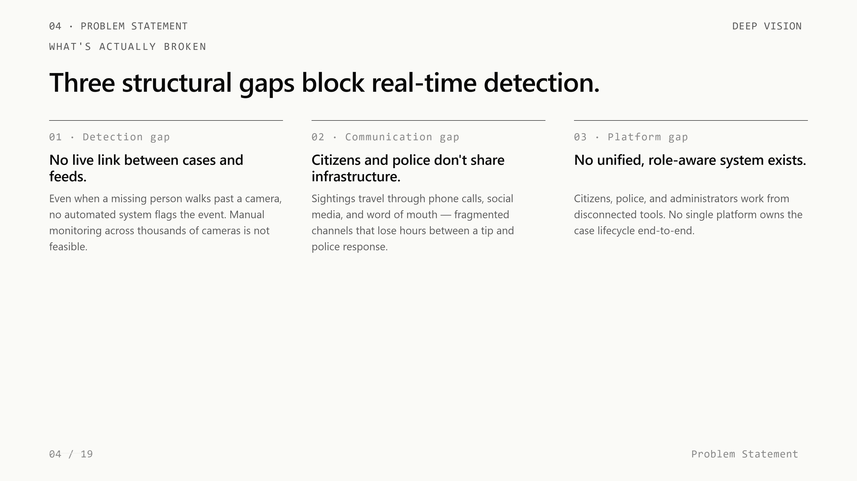
Notes:
We identified three concrete gaps. First, no automated link exists between an active missing person case and live camera feeds — even if the person walks past a camera, nothing flags it. Second, the information flow between citizens who spot a person and the police who respond is fragmented across phone calls, social media, and word of mouth. Third, no unified role-aware platform exists today that brings citizens, police, and administrators together with the same case data.

Slide 5
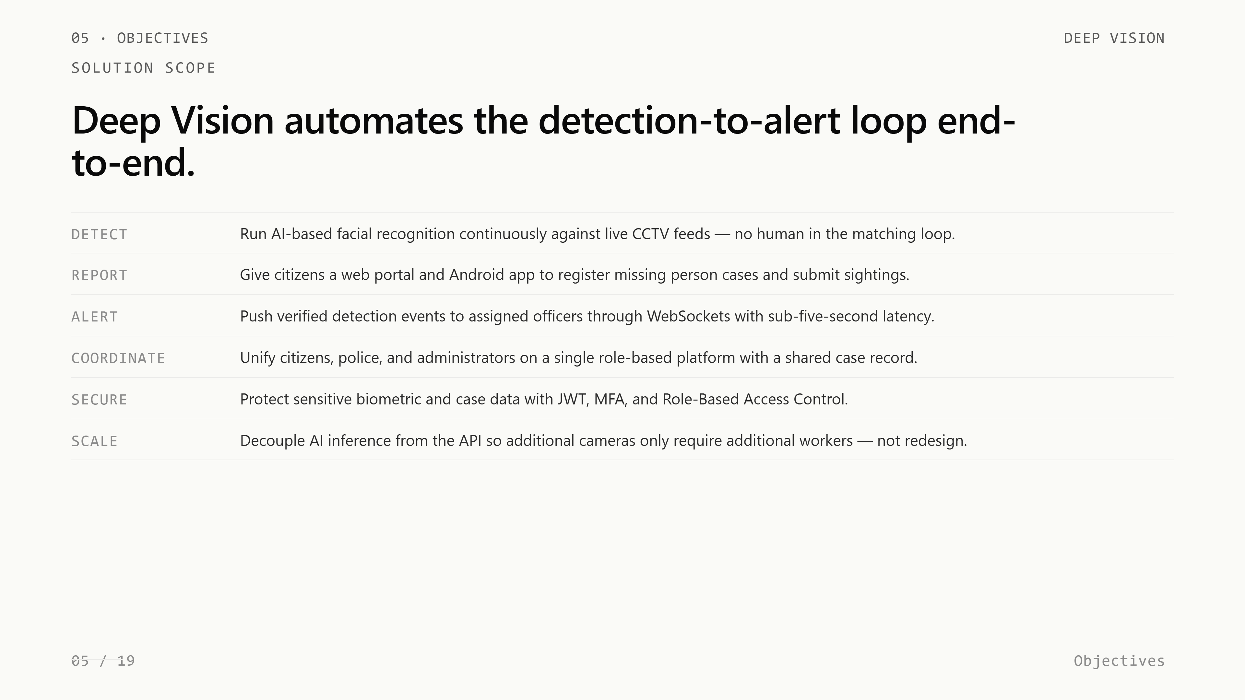
Notes:
Deep Vision addresses all three gaps in a single platform. Citizens register cases through a web portal or Android app, the AI pipeline matches faces from live CCTV feeds against active cases, and verified matches are pushed to police officers in under five seconds over WebSockets. The full lifecycle — register, detect, alert, verify, respond — lives inside one system with role-based access for citizens, police, and admins.

Slide 6
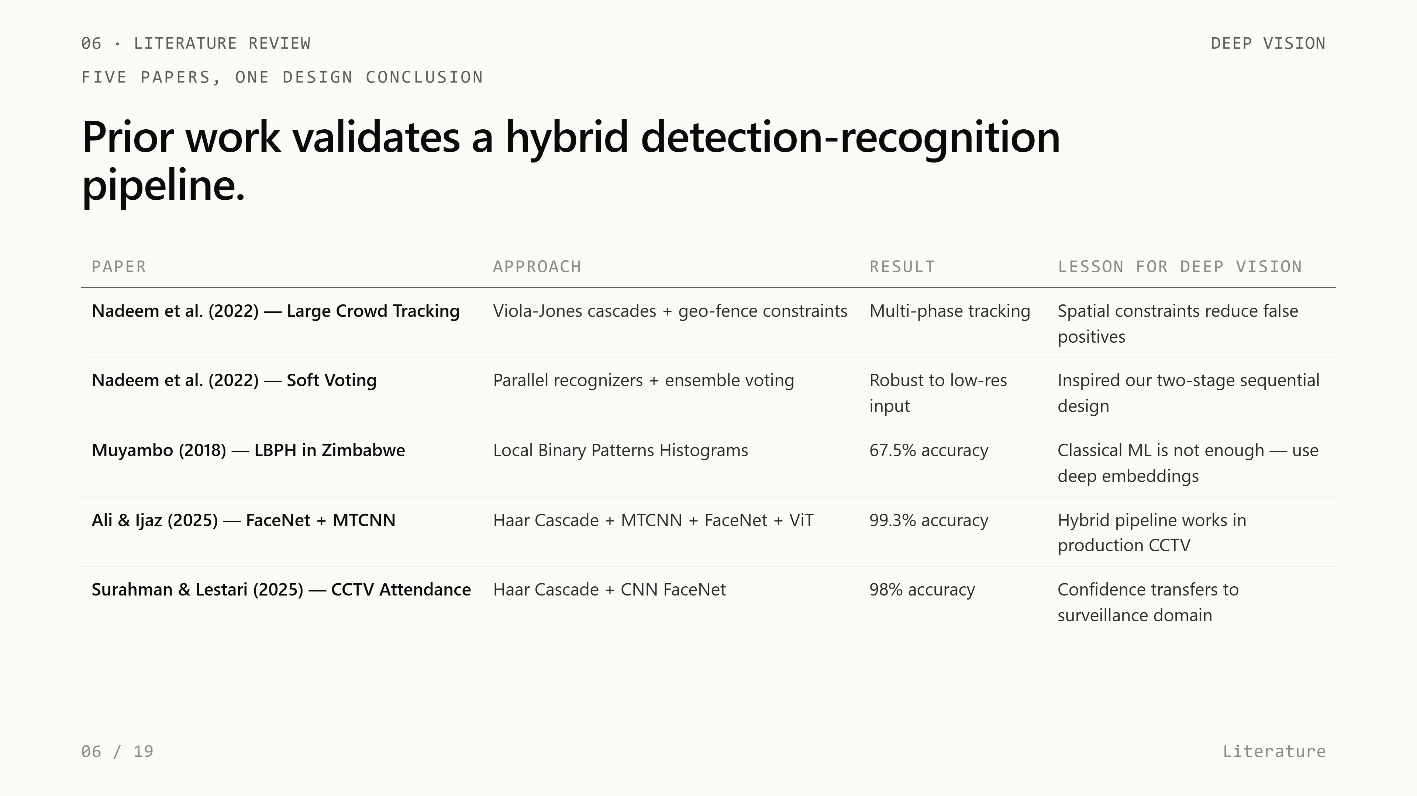
Notes:
We grounded our design in five papers. Nadeem and colleagues showed that geo-fence plus cascade detection works in dense crowds, but cascades alone aren't accurate enough. Muyambo's LBPH-based prototype achieved only 67.5 percent recognition — that gap convinced us to use deep embeddings instead of classical machine learning. Ali and Ijaz, and Surahman and Lestari, both achieved over 98 percent accuracy by combining Haar Cascade screening with deep recognition models like FaceNet — and that hybrid architecture is exactly what we adopted.

Slide 7
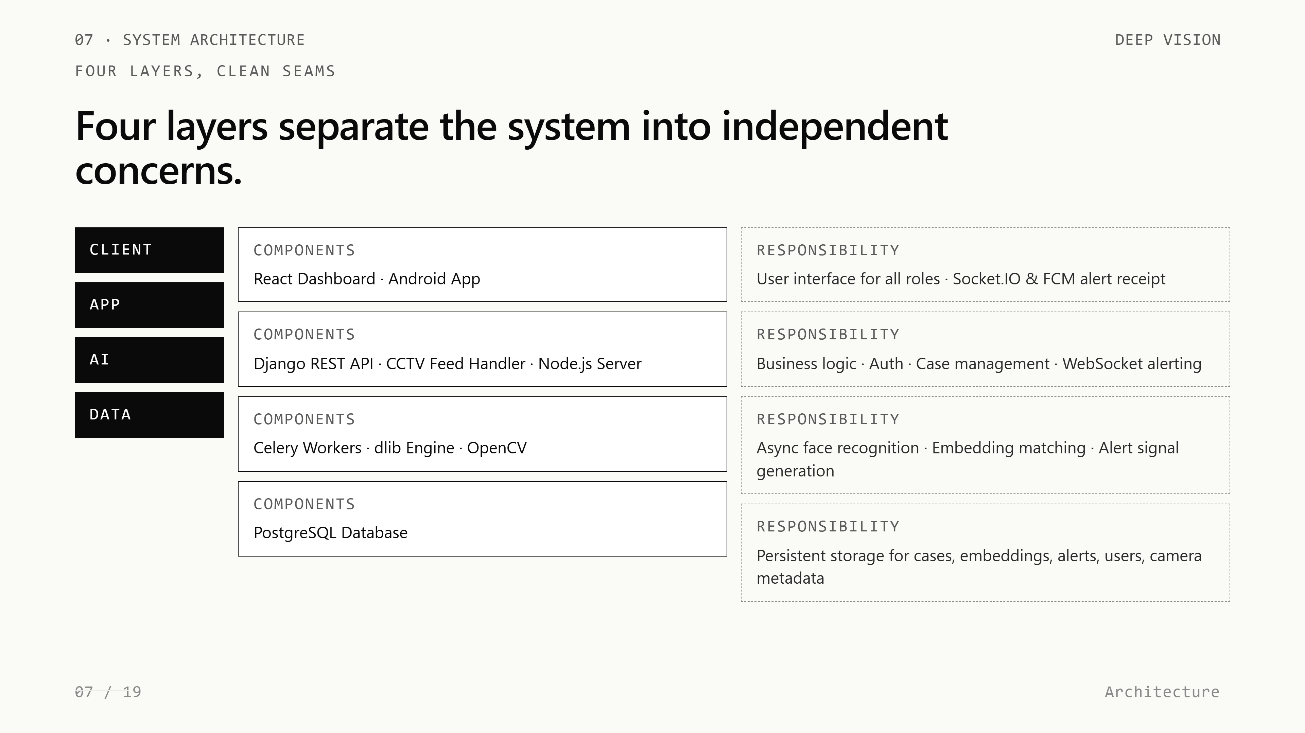
Notes:
Our system has four clean layers. The Client Layer is the React dashboard and the Android app. The App Layer is Django REST Framework plus the Node.js Socket.IO server. The AI Layer is the Celery worker pool running dlib. The Data Layer is PostgreSQL storing cases, embeddings, alerts, and metadata. Each layer can be scaled, tested, and replaced independently — that's the architectural payoff.

Slide 8
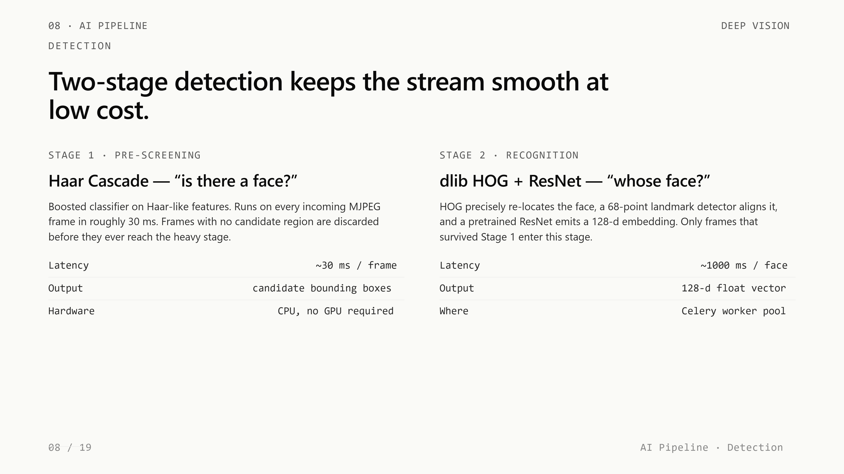
Notes:
The AI pipeline runs in two stages. Stage one is Haar Cascade — a boosted classifier running on every incoming frame, taking around thirty milliseconds per check. It's only asking one question: is there a face here at all? Frames with no face are dropped immediately. Stage two is the heavy stage — dlib's HOG detector plus the ResNet model — and it only runs on frames that survived stage one. This separation is what lets us process live streams without a GPU.

Slide 9
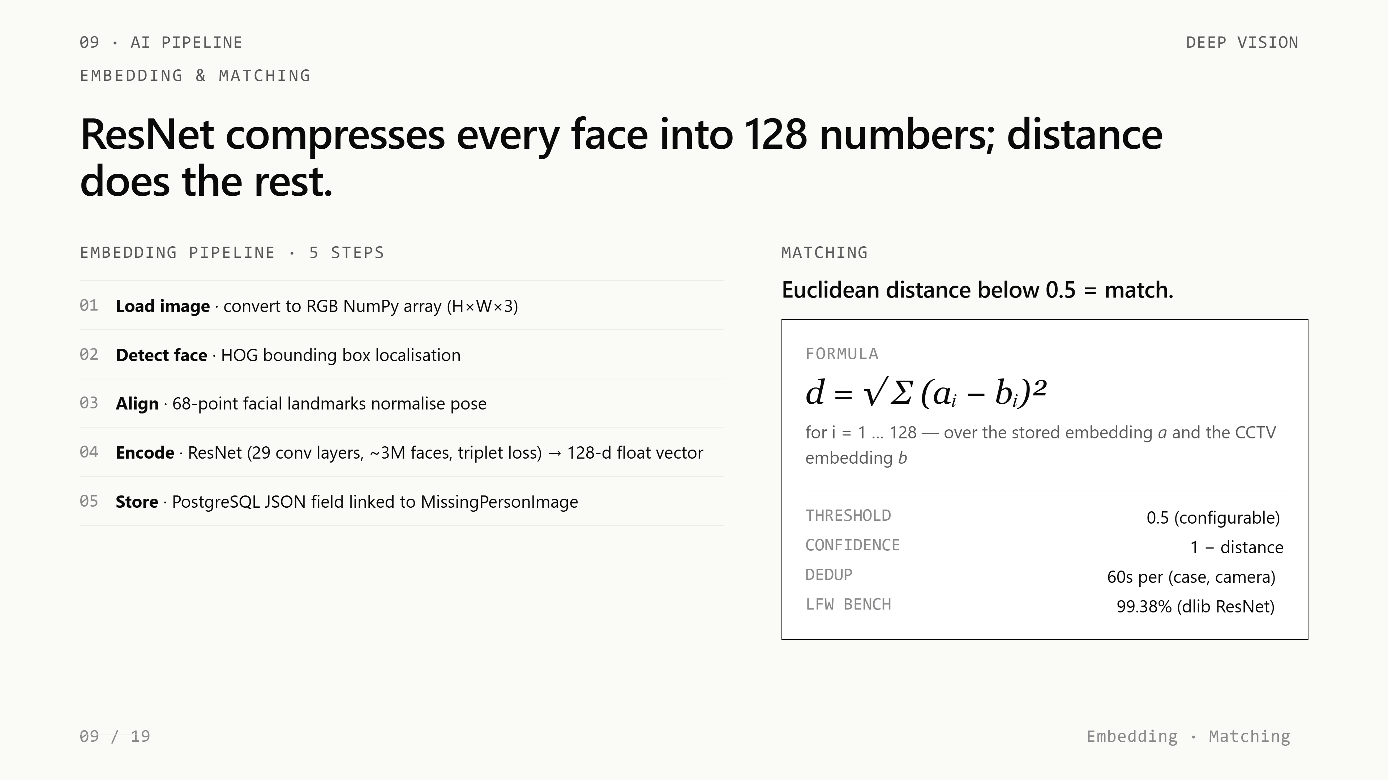
Notes:
When a face reaches stage two, we generate a 128-dimensional embedding. The image is loaded, HOG locates the face, sixty-eight landmarks align the pose, and then a pretrained ResNet — trained on roughly three million faces with triplet loss — produces 128 floating-point numbers. These 128 numbers are the face. We store them as a JSON array in PostgreSQL. dlib's model achieves 99.38 percent accuracy on the Labeled Faces in the Wild benchmark, so we inherit that quality directly.

Slide 10
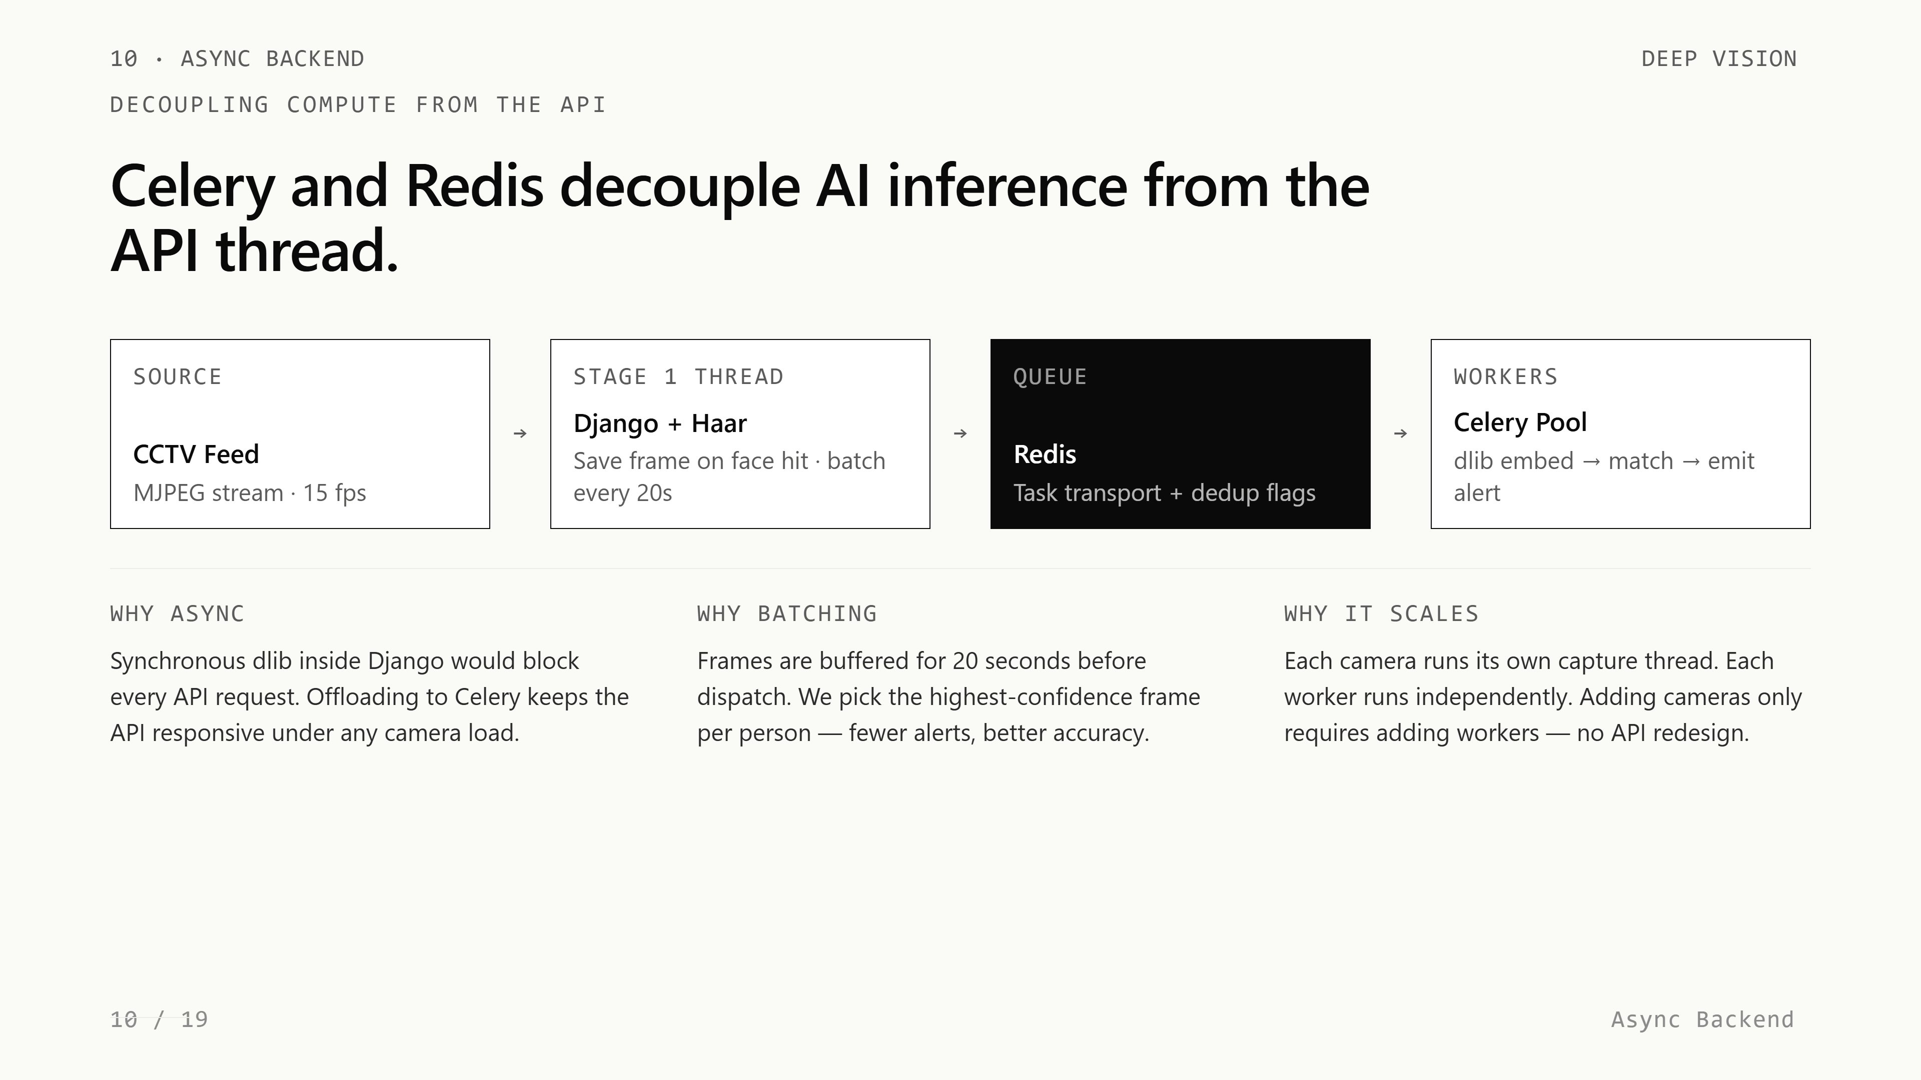
Notes:
Matching two faces is just Euclidean distance between their 128-dimensional vectors. Same person, vectors close. Different people, vectors far apart. We set the threshold at 0.5 — distances below that count as a match, with confidence equal to one minus the distance. Sixty-second deduplication per case-camera pair prevents a single person from triggering dozens of alerts. Once an alert is verified, that person's embedding is excluded from all future matching automatically.

Slide 11
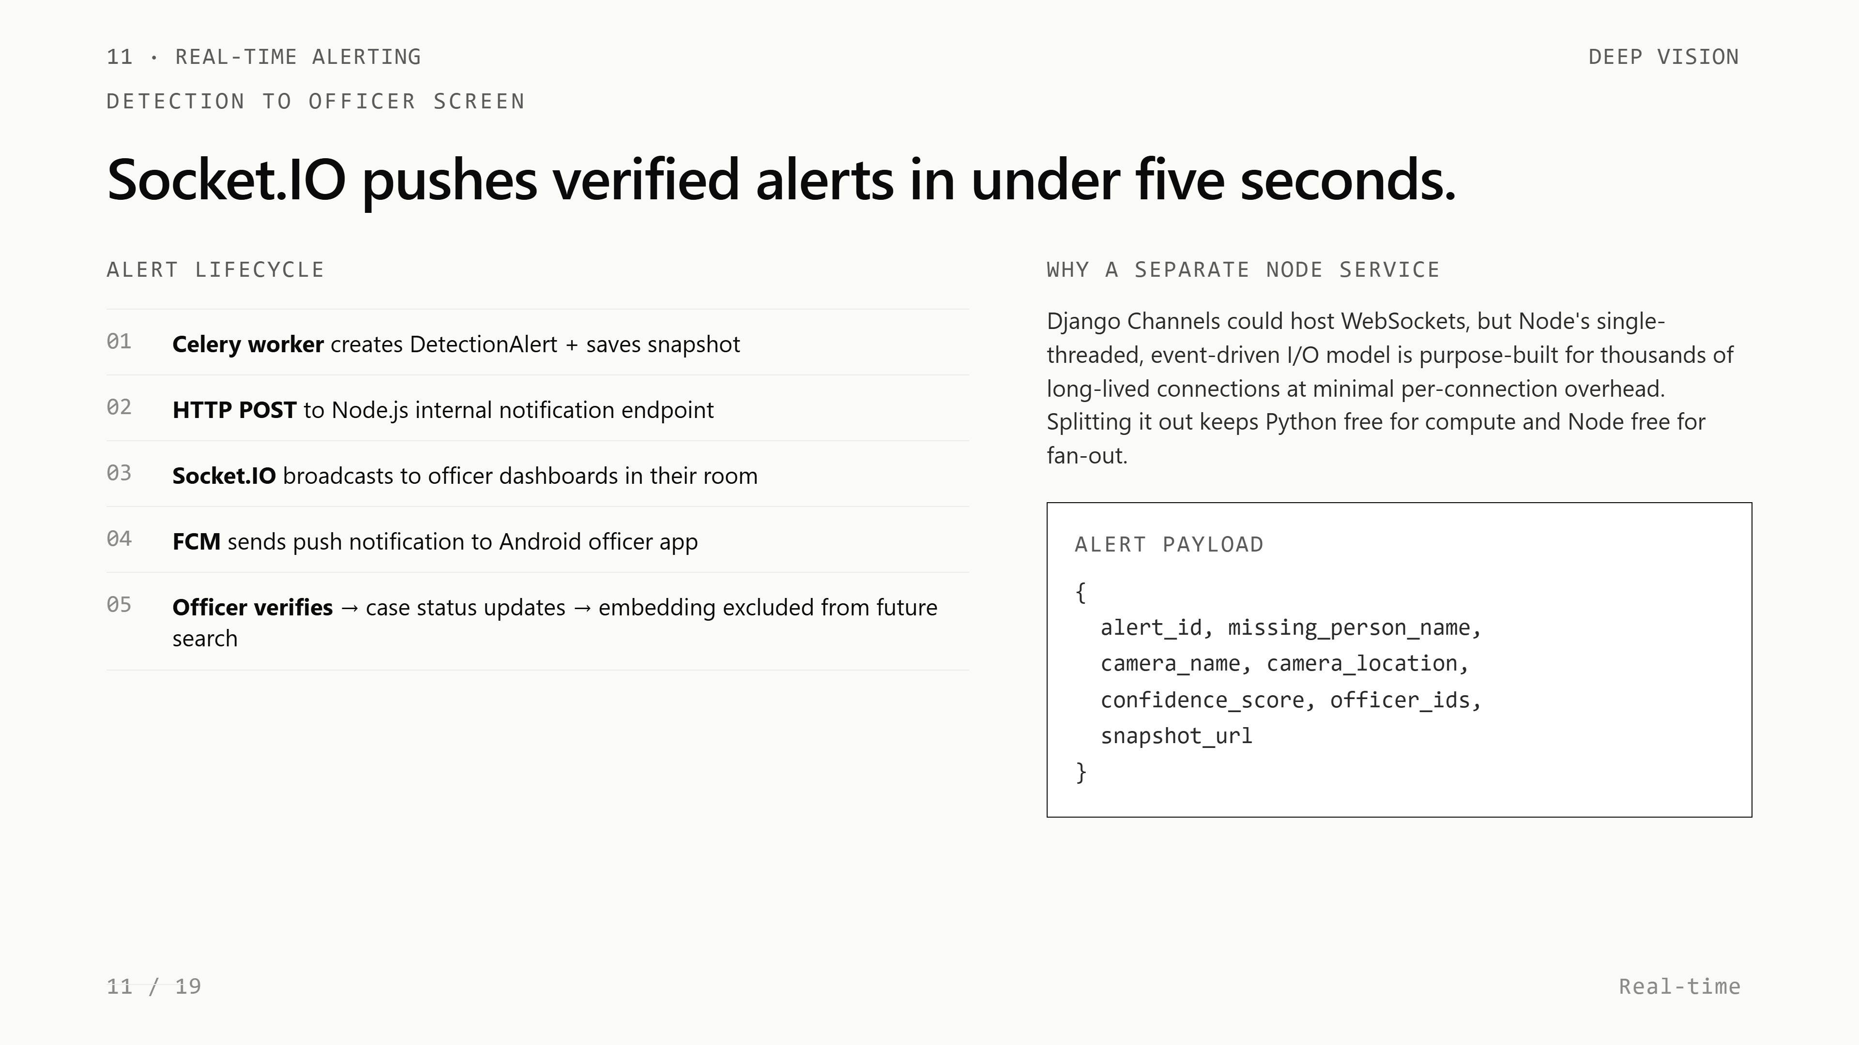
Notes:
Running dlib synchronously inside Django would block every API request. So we offloaded all inference to Celery workers behind a Redis queue. Frames are captured by a background thread, batched every twenty seconds, and dispatched to workers. Workers consume tasks, run the embedding pipeline, generate alerts, and write back to the database. The API stays responsive even when multiple cameras are streaming. Adding more workers scales inference horizontally without touching the API layer.

Slide 12
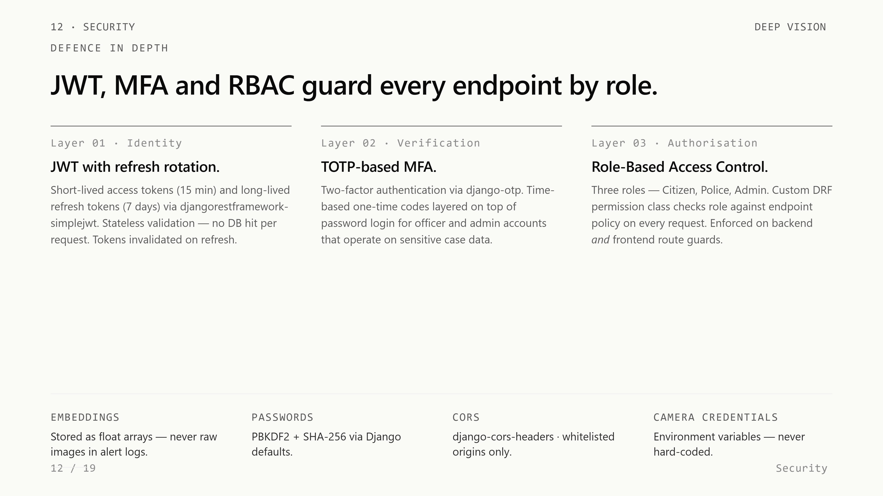
Notes:
Once a Celery worker creates an alert, it POSTs to a Node.js server which we built specifically for real-time delivery. Node's event-driven I/O model handles thousands of long-lived WebSocket connections far better than Django would. Socket.IO broadcasts the alert payload — snapshot URL, camera location, confidence score, timestamp — to all connected police dashboards instantly. Our measured end-to-end latency in controlled conditions is under five seconds from detection to alert card.

Slide 13
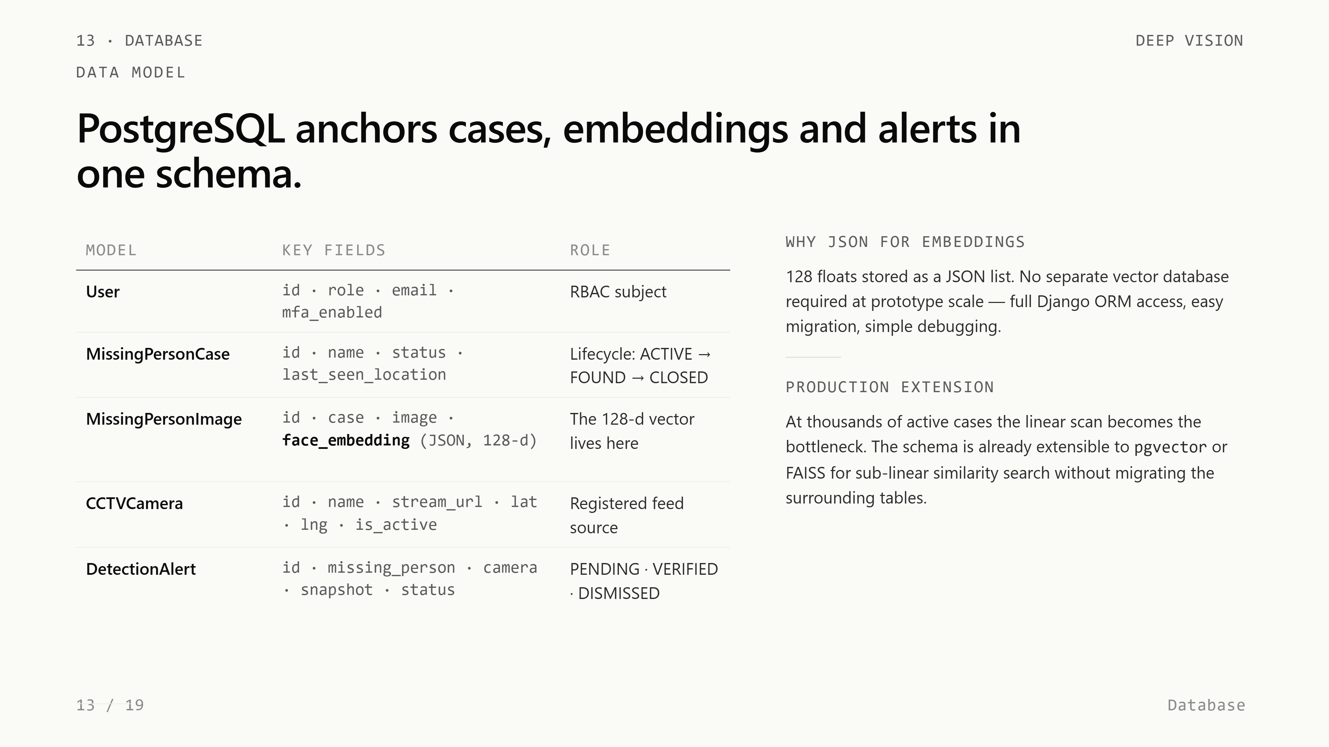
Notes:
Security is layered. Authentication uses JWT access and refresh tokens — short-lived access, long-lived refresh, with rotation. Multi-factor authentication uses TOTP through django-otp. Role-based access control assigns every user to one of three roles — citizen, police, or admin — and a custom DRF permission class checks role against endpoint policy on every request. Face embeddings are stored as float arrays, never raw images in alert logs. Camera credentials live in environment variables.

Slide 14
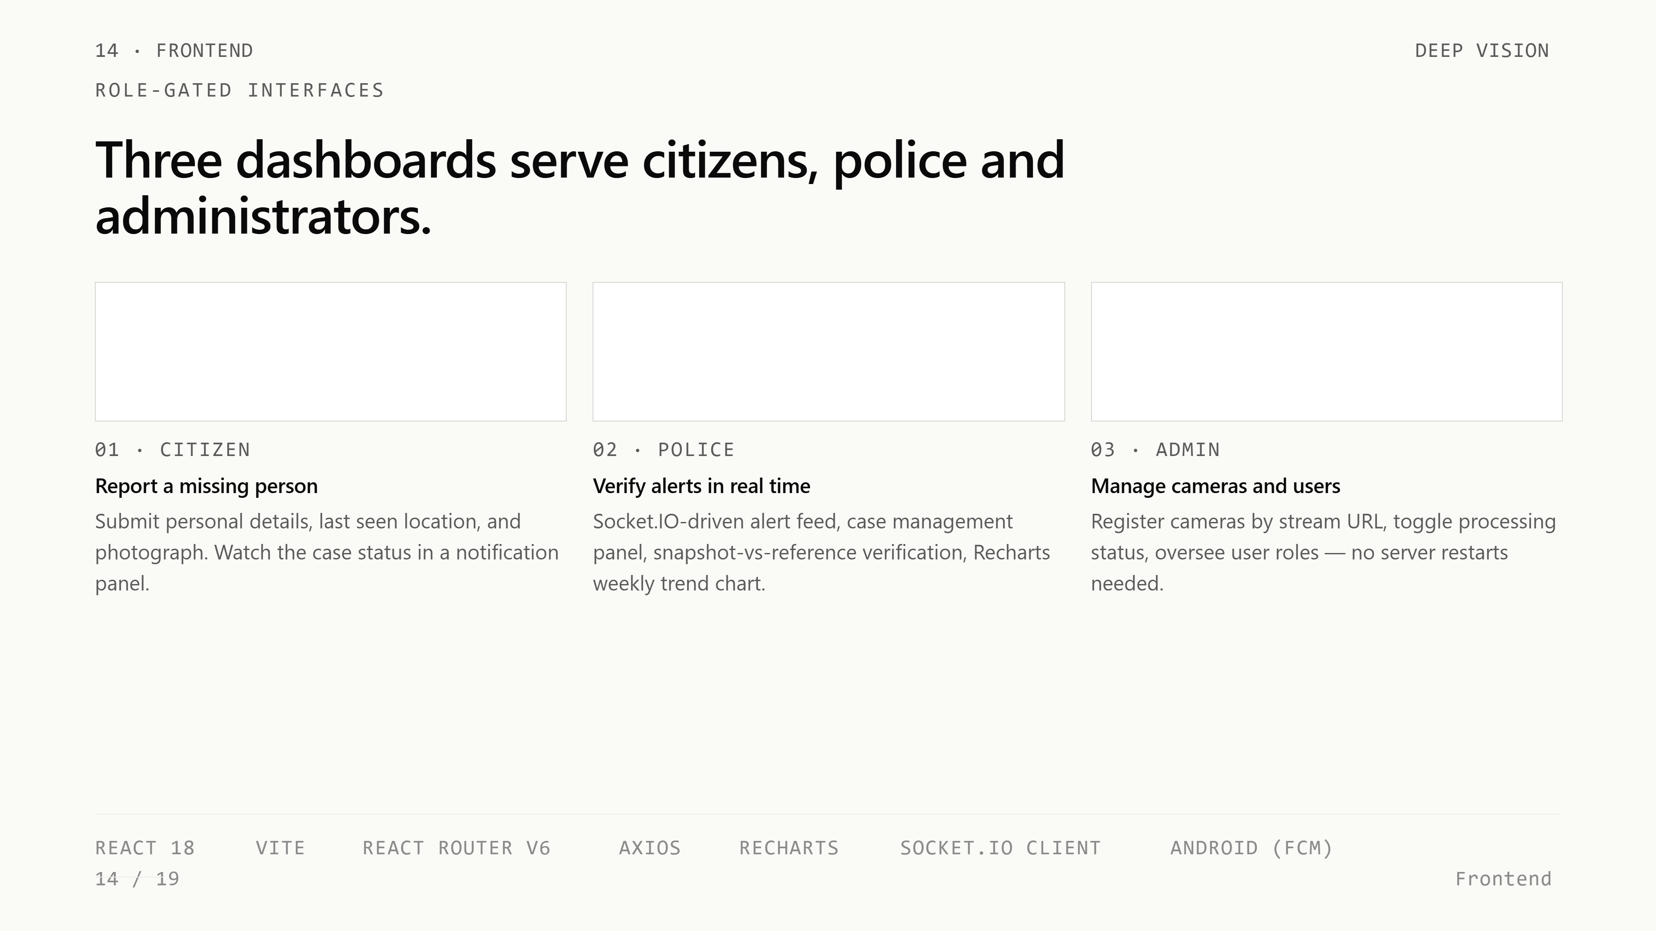
Notes:
The database has five core models. User holds the role for RBAC. MissingPersonCase tracks lifecycle status — active, found, closed. MissingPersonImage stores the photograph and its 128-dimensional embedding as a JSON field. CCTVCamera holds the stream URL, name, latitude and longitude. DetectionAlert links a case to a camera with the snapshot, confidence score, and verification status. The JSON-field approach avoids a vector database for now but stays extensible to pgvector at production scale.

Slide 15
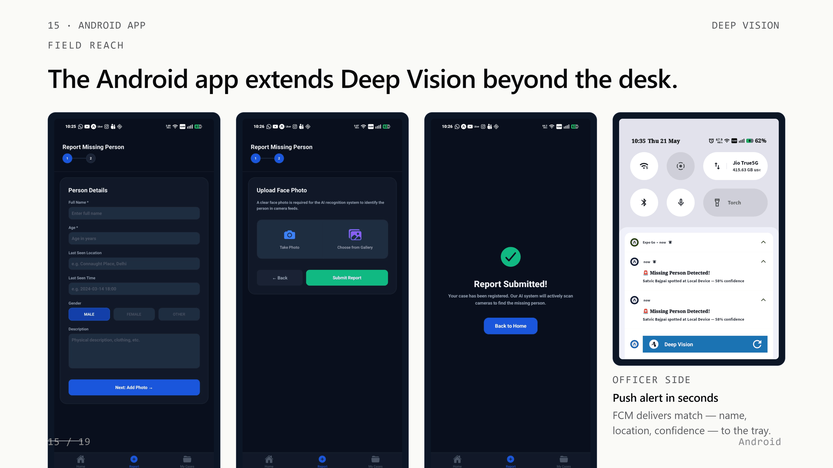
Notes:
The frontend is React 18 with Vite, and it presents three role-gated dashboards. The citizen dashboard is for submitting missing person reports with a photograph. The police dashboard is the operational center — it shows the live alert feed driven by Socket.IO, case lists, and the verify-or-reject workflow. The admin dashboard manages cameras and users. The Android app mirrors the citizen flow and adds FCM push notifications for officers in the field.

Slide 16
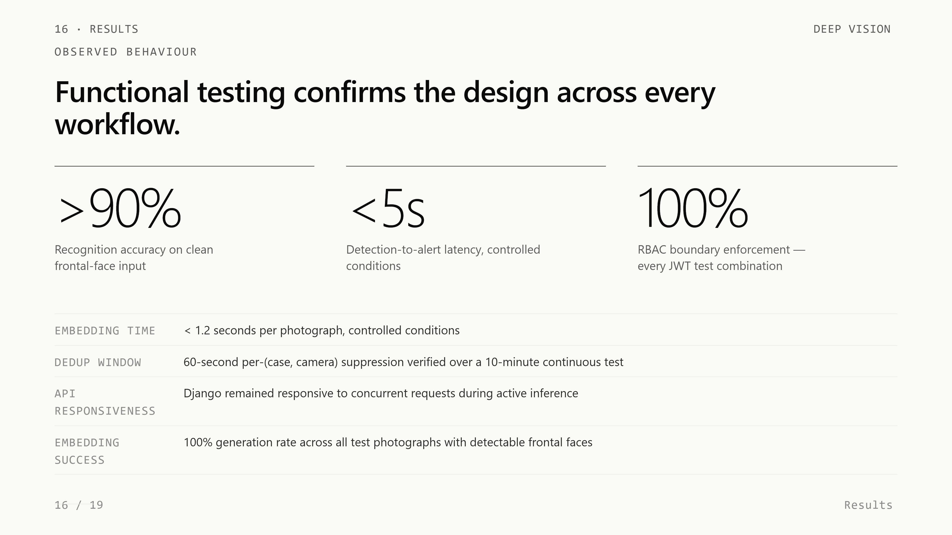
Notes:
The Android app extends reach beyond the desk. A citizen opens the app, fills in the person's details — name, age, last-seen location, description — and uploads a clear face photo. The same Django endpoints used by the web client receive the submission, the embedding pipeline runs, and the case becomes active. On the officer side, when a match is confirmed, Firebase Cloud Messaging delivers a push notification to the tray with the missing person's name, the camera location, and the confidence score — the officer doesn't need to open the app to know there's a match. Citizens and officers carry the platform with them.

Slide 17
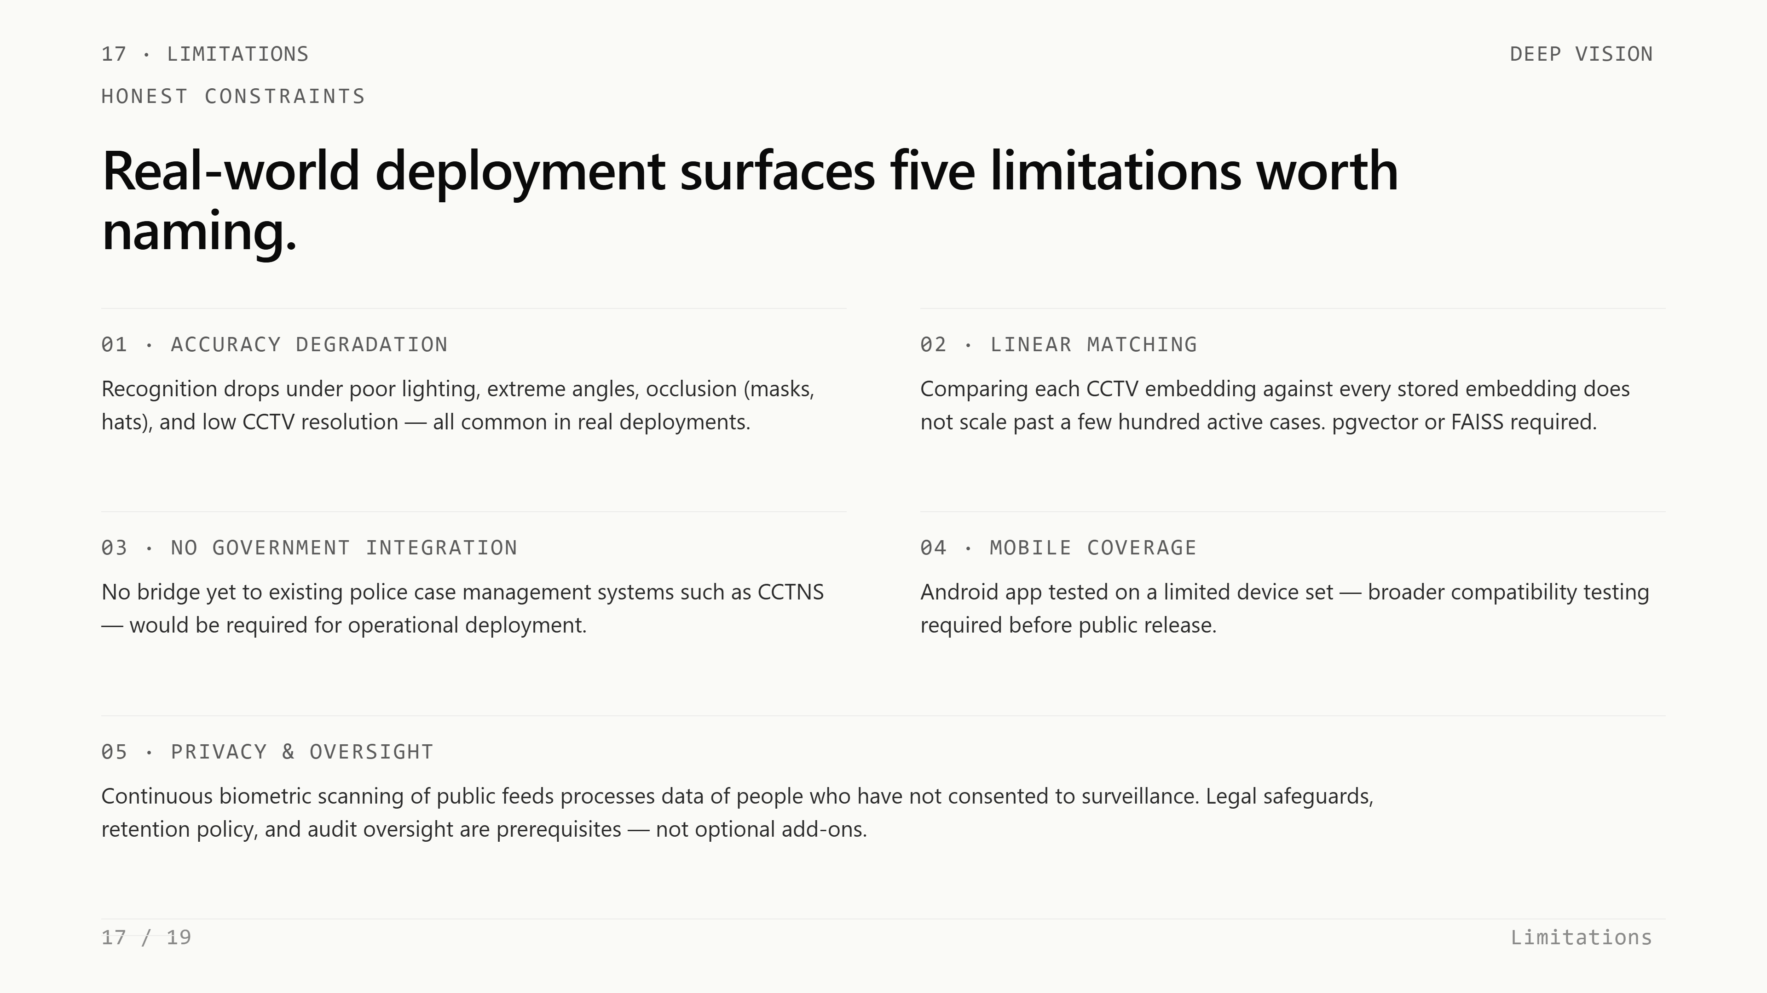
Notes:
We tested every workflow end-to-end. Face recognition accuracy is above ninety percent on clean frontal-face inputs. Detection-to-alert latency is under five seconds in controlled conditions. Embedding generation runs in under one-point-two seconds per photo. Role boundaries held in every JWT test combination — citizens could not reach police endpoints, police could not reach admin endpoints. The deduplication filter suppressed repeat alerts correctly over a ten-minute continuous test.

Slide 18
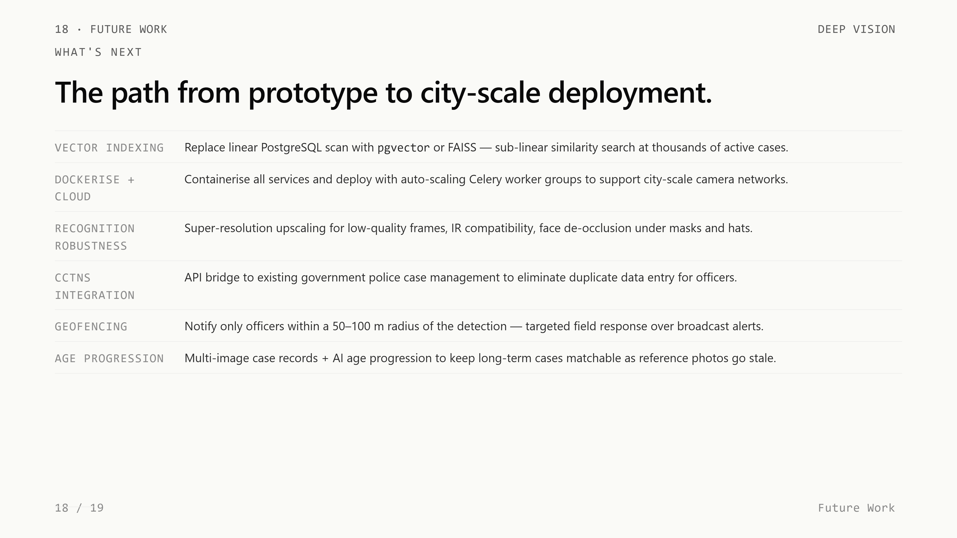
Notes:
We're honest about the limitations. Accuracy drops under poor lighting, severe occlusion, and very low resolution — all common in real CCTV. Linear scanning of embeddings will not scale past a few hundred active cases; we need pgvector or FAISS at production scale. There's no integration yet with government systems like CCTNS. And the privacy question is real — continuous biometric scanning of public feeds needs legal safeguards and retention policy before any deployment. Future work covers all of these: vector indexing, Docker plus cloud auto-scaling, geofencing for targeted alerts, and age-progression for long-term cases.

Slide 19

Notes:
Thank you. We're happy to take questions. The full source is on GitHub, and the report contains every detail we couldn't fit in these eighteen slides.

